Slide 1
The Analysis and Design of Computer Algorithms
CIS*3490 Winter 2021

Slide 2
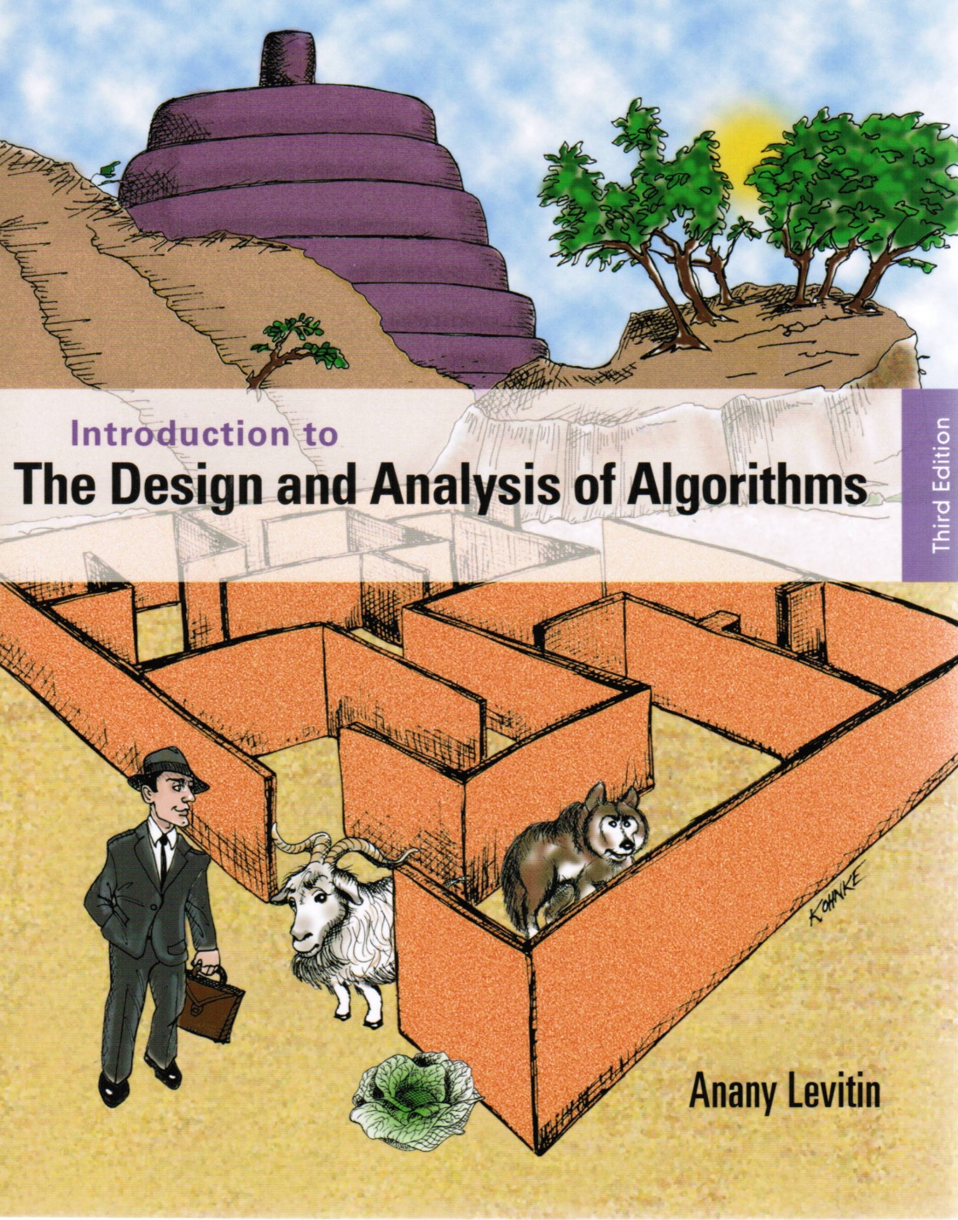
Chapter 7
Space and Time
Tradeoffs

Slide 3

Space-for-Time Tradeoffs
Two varieties of space-for-time algorithms:
input enhancement — preprocess the input (or its part) to store some info to be used later in solving the problem
counting sorts
string searching algorithms
prestructuring — preprocess the input to make accessing its elements easier
hashing
indexing schemes (e.g., B-trees)

Slide 4
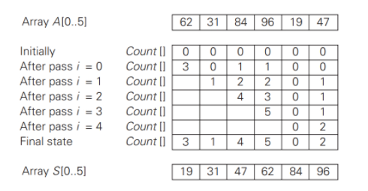
Sorting by Counting
A is the array to be sorted. S is the sorting result.
Create array Count [ ] to store counts.
Initialize Count [ ] elements to zero.
For each element A [ i ], compare it with all elements A [ j ] (j > i).
If A [ i ] < A [ j ], increase Count [ j ] by 1, otherwise, increase Count [ i ] by 1.
For all i, copy A [ i ] to S [ k ], where k = Count [ i ].

Slide 5
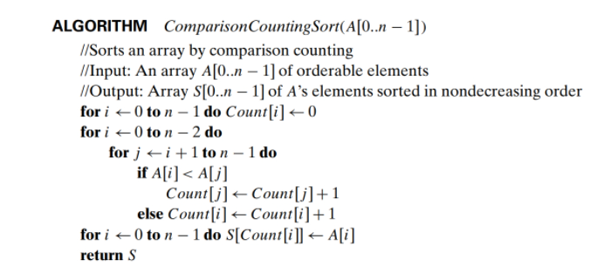
Sorting by Counting
Efficiency: Θ (n²)

Slide 6
Review: String searching by brute force
pattern: a string of m characters to search for
text: a (long) string of n characters to search in
Brute force algorithm
Step 1 Align pattern at beginning of text
Step 2 Moving from left to right, compare each character of pattern to the corresponding character in text until either all characters are found to match (successful search) or a mismatch is detected
Step 3 While a mismatch is detected and the text is not yet exhausted, realign pattern one position to the right and repeat Step 2

Slide 7
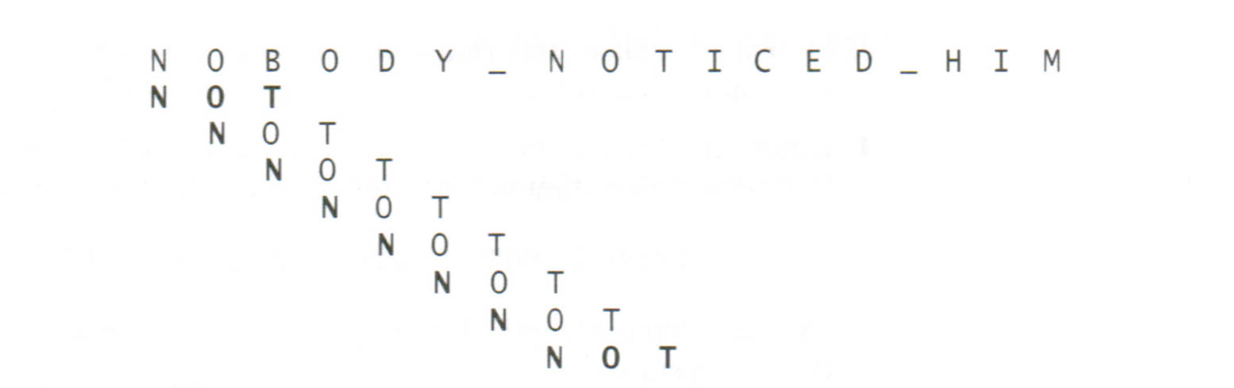
Example of Brute-Force String Searching

Slide 8
String Searching by preprocessing
Several string searching algorithms are based on the input
enhancement idea of preprocessing the pattern
Boyer-Moore algorithm preprocesses pattern right to left and store information into two tables
Horspool’s algorithm simplifies the Boyer-Moore algorithm by using just one table

Slide 9
Horspool’s Algorithm
A simplified version of Boyer-Moore algorithm:
preprocesses pattern to generate a shift table that determines how much to shift the pattern when a mismatch occurs
always makes a shift based on the text’s character c aligned with the last character in the pattern according to the shift table’s entry for c

Slide 10
Examples of Horspool’s algorithm application
A B C D E F G H I J K L M N O P Q R S T U V W X Y Z
_
BARD LOVED BANANAS
BAOBAB
BAOBAB
BAOBAB
BAOBAB (unsuccessful search)
1 2 6 6 6 6 6 6 6 6 6 6 6 6 3 6 6 6 6 6 6 6 6 6 6 6
6
6
2
6

Slide 11
How far to shift?
Look at the character c in text that is aligned with the last (rightmost) character in pattern:
Case 1: The character is not in the pattern -- shift the pattern by its length
.....c...................... (c not in pattern)
BAOBAB
Case 2: The character c is in the pattern (but not the rightmost) – shift the pattern to align the rightmost c in pattern with the c in the text.
.....O...................... (A occurs in pattern)
BAOBAB
BAOBAB
BAOBAB

Slide 12
How far to shift?
Look at the character c in text that is aligned with the last (rightmost) character in pattern:
Case 1: The character is not in the pattern -- shift the pattern by its length
.....c...................... (c not in pattern)
BAOBAB
Case 2: The character c is in the pattern (but not the rightmost) – shift the pattern to align the rightmost c in pattern with the c in the text.
.....O...................... (A occurs in pattern)
BAOBAB
BAOBAB
BAOBAB

Slide 13
How far to shift?
Look at the character c in text that is aligned with the last character in pattern:
Case 3: The rightmost characters do match and there are other c in the text – shift the pattern so that the next c in the pattern aligns the c in the text.
.....B......................
BAOBAB
Case 4: The rightmost characters do match and no other c in the pattern -- shift the pattern by its length
.....B......................
EAOTAB
BAOBAB
EAOTAB

Slide 14
Shift Table
Shift sizes can be precomputed by the formula
distance from c’s rightmost occurrence in pattern among its first m-1 characters to its right end (cases 2 and 3)
t(c) =
pattern’s length m, otherwise (cases 1 and 4)
by scanning pattern before search begins and stored in a table called shift table
B A O B A B
m-1
1
A B C D E F G H I J K L M N O P Q R S T U V W X Y Z
2
1 2 6 6 6 6 6 6 6 6 6 6 6 6 3 6 6 6 6 6 6 6 6 6 6 6
3

Slide 15
Examples of Horspool’s algorithm application
In-class exercise:
Create shift table for pattern BARBER

Slide 16
Examples of Horspool’s algorithm application
Solution to In-class exercise:
Create shift table for pattern BARBER
B A R B E R
1
2
3
4
A B C D E F G H I J K L M N O P Q R S T U V W X Y Z
_
4 2 6 6 1 6 6 6 6 6 6 6 6 6 6 6 6 3 6 6 6 6 6 6 6 6
6

Slide 17
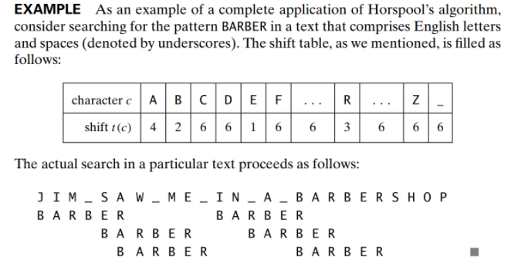
Examples of Horspool’s algorithm application

Slide 18
Boyer-Moore Algorithm
Based on same two ideas:
comparing pattern characters to text from right to left
precomputing shift sizes in two tables
bad-symbol table indicates how much to shift based on text’s character causing a mismatch
good-suffix table indicates how much to shift based on matched part (suffix) of the pattern

Slide 19
Bad-Symbol Shift in Boyer-Moore Algorithm
If the rightmost character of the pattern doesn’t match, the BM algorithm acts as Horspool’s
If the rightmost character of the pattern does match, BM compares preceding characters right to left until either all pattern’s characters match or a mismatch on text’s character c is encountered after k > 0 matches
text
pattern
bad-symbol shift d₁ = max{t₁(c ) - k, 1}
c
k matches

Slide 20
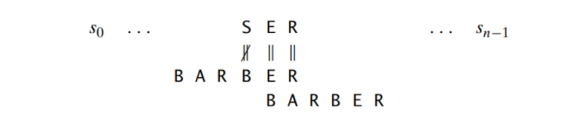
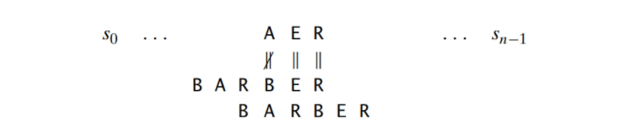
Bad-Symbol Shift in Boyer-Moore Algorithm
A B C D E F G H I J K L M N O P Q R S T U V W X Y Z
_
4 2 6 6 1 6 6 6 6 6 6 6 6 6 6 6 6 3 6 6 6 6 6 6 6 6
6
1
d₁ = max{t₁(c) - k, 1}
k = 2
d₁ = max{t₁(S) - 2, 1}
= max{6 - 2, 1} = 4
d₁ = max{t₁(A) - 2, 1}
= max{4 - 2, 1} = 2
2

Slide 21
Example of Boyer-Moore algorithm application
B E S S _ K N E W _ A B O U T _ B A O B A B S
B A O B A B
d₁ = t₁(K) = 6 B A O B A B
d₁ = t₁(_)-2 = 4
d₂(2) = 5
B A O B A B
d₁ = t₁(_)-1 = 5
d₂(1) = 2
B A O B A B (success)
Bad symbol table
A B C D E F G H I J K L M N O P Q R S T U V W X Y Z
_
1 2 6 6 6 6 6 6 6 6 6 6 6 6 3 6 6 6 6 6 6 6 6 6 6 6
6
k | pattern | d₂
1 | BAOBAB | 2
2 | BAOBAB | 5
3 | BAOBAB | 5
4 | BAOBAB | 5
5 | BAOBAB | 5
Good suffix table

Slide 22
Example of Boyer-Moore algorithm application
B E S S _ K N E W _ A B O U T _ B A O B A B S
B A O B A B
d₁ = t₁(K) = 6 B A O B A B
d₁ = t₁(_)-2 = 4
d₂(2) = 5
B A O B A B
d₁ = t₁(_)-1 = 5
d₂(1) = 2
B A O B A B (success)
Bad symbol table
A B C D E F G H I J K L M N O P Q R S T U V W X Y Z
_
1 2 6 6 6 6 6 6 6 6 6 6 6 6 3 6 6 6 6 6 6 6 6 6 6 6
6
k | pattern | d₂
1 | BAOBAB | 2
2 | BAOBAB | 5
3 | BAOBAB | 5
4 | BAOBAB | 5
5 | BAOBAB | 5
Good suffix table

Slide 23
Good-Suffix Shift in Boyer-Moore Algorithm
Good-suffix shift d₂ is applied after 0 < k < m last characters were matched
d₂(k) = the distance between matched suffix of size k and its rightmost occurrence in the pattern that is not preceded by the same character as the suffix Example: ABCBAB d₂(1) = 2, d₂(2) = 4
If there is no such occurrence, match the longest part of the k-character suffix with corresponding prefix; if there are no such suffix-prefix matches, d₂ (k) = m Example: ABCBAB d₂(3) = 4, d₂(4) = 4, d₂(5) = 4
ABCBAB
ABCBAB
ABCBAB
ABCBAB
ABCBAB
ABCBAB
ABCBAB
ABCBAB
ABCBAB
ABCBAB
k = 1
2
k = 2
4
k = 3
4
k | d₂
1 | 2
2 | 4
3 | 4
4 | 4
5 | 4
k = 4
4
k = 5
4

Slide 24
Good-Suffix Shift in Boyer-Moore Algorithm
Good-suffix shift d₂ is applied after 0 < k < m last characters were matched
d₂(k) = the distance between matched suffix of size k and its rightmost occurrence in the pattern that is not preceded by the same character as the suffix Example: ABCBAB d₂(1) = 2, d₂(2) = 4
If there is no such occurrence, match the longest part of the k-character suffix with corresponding prefix; if there are no such suffix-prefix matches, d₂ (k) = m Example: ABCBAB d₂(3) = 4, d₂(4) = 4, d₂(5) = 4
ABCBAB
ABCBAB
ABCBAB
ABCBAB
ABCBAB
ABCBAB
ABCBAB
ABCBAB
ABCBAB
ABCBAB
k = 1
2
k = 2
4
k = 3
4
k | d₂
1 | 2
2 | 4
3 | 4
4 | 4
5 | 4
k = 4
4
k = 5
4

Slide 25
Good-Suffix Shift in Boyer-Moore Algorithm
Good-suffix shift d₂ is applied after 0 < k < m last characters were matched
d₂(k) = the distance between matched suffix of size k and its rightmost occurrence in the pattern that is not preceded by the same character as the suffix Example: ABCBAB d₂(1) = 2, d₂(2) = 4
If there is no such occurrence, match the longest part of the k-character suffix with corresponding prefix; if there are no such suffix-prefix matches, d₂ (k) = m Example: ABCBAB d₂(3) = 4, d₂(4) = 4, d₂(5) = 4
ABCBAB
ABCBAB
ABCBAB
ABCBAB
ABCBAB
ABCBAB
ABCBAB
ABCBAB
ABCBAB
ABCBAB
k = 1
2
k = 2
4
k = 3
4
k | d₂
1 | 2
2 | 4
3 | 4
4 | 4
5 | 4
k = 4
4
k = 5
4

Slide 26
Good-Suffix Shift in Boyer-Moore Algorithm
In-class exercise:
Create good-suffix table for pattern BAOBAB

Slide 27
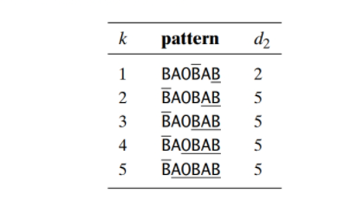
Good-Suffix Shift in Boyer-Moore Algorithm
BAOBAB
BAOBAB
BAOBAB
BAOBAB
BAOBAB
BAOBAB
BAOBAB
BAOBAB
BAOBAB
BAOBAB
Solution to In-class exercise:
Create good-suffix table for pattern BAOBAB
k = 1
2
k = 2
5
k = 3
5
k = 4
5
k = 5
5

Slide 28

Steps in Boyer-Moore Algorithm
Step 1 Fill in the bad-symbol shift table $t_{1}$
Step 2 Fill in the good-suffix shift table $d_{2}$
Step 3 Align the pattern against the beginning of the text
Step 4 Repeat until a matching substring is found or text ends:
Compare the corresponding characters right to left.
If no characters match, retrieve entry t₁(c) from the bad-symbol table for the text’s character c causing the mismatch and shift the pattern to the right by t₁(c). If 0 < k < m characters are matched, retrieve entry t₁(c) from the bad-symbol table for the text’s character c causing the mismatch and entry d₂(k) from the good-suffix table and shift the pattern to the right by
d = max {d₁, d₂} where d₁ = max{t₁(c) - k, 1}.

Slide 29
Example of Boyer-Moore algorithm application
B E S S _ K N E W _ A B O U T _ B A O B A B S
B A O B A B
d₁ = t₁(K) = 6 B A O B A B
d₁ = t₁(_)-2 = 4
d₂(2) = 5
B A O B A B
d₁ = t₁(_)-1 = 5
d₂(1) = 2
B A O B A B (success)
A B C D E F G H I J K L M N O P Q R S T U V W X Y Z
_
1 2 6 6 6 6 6 6 6 6 6 6 6 6 3 6 6 6 6 6 6 6 6 6 6 6
6
k | pattern | d₂
1 | BAOBAB | 2
2 | BAOBAB | 5
3 | BAOBAB | 5
4 | BAOBAB | 5
5 | BAOBAB | 5

Slide 30
Hashing
A very efficient method for implementing a dictionary, i.e., a set with the operations:
find
insert
delete
Based on representation-change and space-for-time tradeoff ideas
Important applications:
symbol tables
databases (extendible hashing)

Slide 31
Hashing
Hash function
Hash table
File
h
…

Slide 32
Design techniques and problem types
 | Search | Sorting | Tree | Graph | Other
Brute force, exhaustive search | Sequential search, Sequential string match | Selection sort, Bubble sort |  | Traveling salesman problem, DFS, BFS | Knapsack problem, Assignment problem
Decrease and conquer | Binary search | Insertion sort | Binary search tree | Topological sorting | Exponentiation by squaring
Divide and conquer |  | Mergysort, Quicksort | Binary tree traversal |  | Matrix multiplication, Large integer multiplication
Transform and conquer | Presorting | Heapsort | AVL tree, 2-3 tree |  | Gaussian elimination, Polynomial evaluation
Space and time tradeoff | Hashing, Horspool algorithm, BM algorithm | Sorting by counting
Dynamic programming |  |  | Optimal binary search trees | Warshall’s algorithm, Shortest paths problem | Knapsack problem, Memory functions
Greedy techniques |  |  |  | Minimum spanning tree | Huffman trees
Iterative improvement |  |  |  | Maximum flow Bipartite graphs | Stable marriage problem
Backtracking Branch & bound |  |  |  | Traveling salesman problem, | N-queens, Assignment, Knapsack

Slide 33
Recommended Reading
7.1
7.2

